Slide 1
Construction
Maths in the workplace

Slide 2
How our teaching resources are designed for the classroom

Slide 3
I can understand how maths is used in the construction industry.

Slide 4
The front elevation of a solid is the view of it from the front.
The side elevation of a solid is the view of it from the side.
The area is the size of the surface and states the number of unit squares needed to completely cover that surface.

Slide 5

Construction
Using formulae in the construction industry
Costing in the construction industry

Slide 6

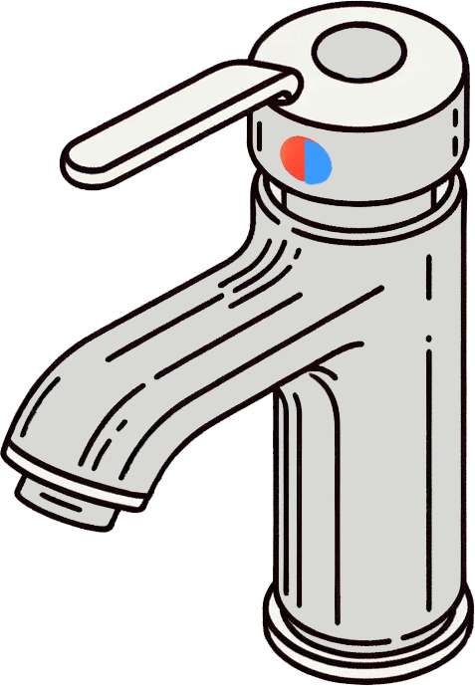
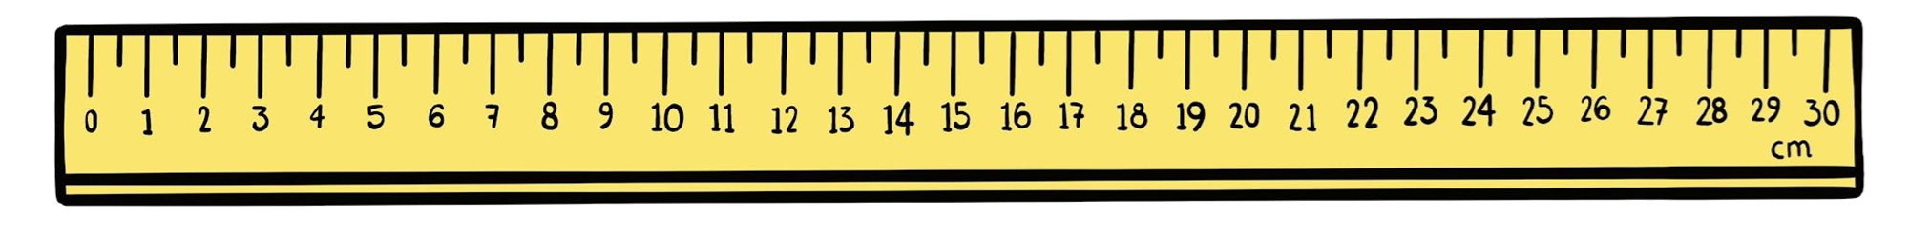
Using formulae in the construction industry
What areas of maths do you think a construction worker might use?
Area & volume
Plans & elevations
Ratio
Percentages
Money
Measures
Proportion
Formulae
Standard form
During this lesson we will look at some of these.

Slide 7
Using formulae in the construction industry
You might find it hard to believe that many formulae are used in the construction industry. Can you think of any formulae that might be used?
Here are some examples of formulae that the construction industry uses:
Total concrete quantity = volume of concrete × 1.54
Slope (as a percentage) = (vertical distance ÷ horizontal distance) × 100
Number of bricks = (wall volume × 1000) ÷ (brick volume + mortar volume)
Height = 2.304 × pressure
Ohm’s Law
Joule’s Law
Which type of construction worker do you think uses these formulae?
A builder

Slide 8
Using formulae in the construction industry
You might find it hard to believe that many formulae are used in the construction industry.
Can you think of any formulae that might be used?
Here are some examples of formulae that the construction industry uses:
Total concrete quantity = volume of concrete × 1.54
Slope (as a percentage) = (vertical distance ÷ horizontal distance) × 100
Number of bricks = (wall volume × 1000) ÷ (brick volume + mortar volume)
Height = 2.304 × pressure
Ohm’s Law
Joule’s Law
Which type of construction worker do you think uses these formulae?
A plumber

Slide 9
Using formulae in the construction industry
You might find it hard to believe that many formulae are used in the construction industry.
Can you think of any formulae that might be used?
Here are some examples of formulae that the construction industry uses:
Total concrete quantity = volume of concrete × 1.54
Slope (as a percentage) = (vertical distance ÷ horizontal distance) × 100
Number of bricks = (wall volume × 1000) ÷ (brick volume + mortar volume)
Height = 2.304 × pressure
Ohm’s Law
Joule’s Law
Which type of construction worker do you think uses these formulae?
An electrician

Slide 10
Using formulae in the construction industry
Here is another example of a formula used by builders.
Length of rafter² = Rise of rafter² + run of rafter²
Length of rafter
c
b
Rise
of rafter
a
Run of rafter
c² = +
b²
a²
Does this look familiar?
It is Pythagoras’ theorem.

Slide 11
Using formulae in the construction industry
Here are the front and side elevations of a shed.
The builder needs to replace the rafters of the shed.
How long are the rafters?
c
b
b = 2.31 − 1.8
b = 0.51
a
a = 2.38 ÷ 2
a = 1.19
2.31 m
1.8 m
1.3 m
2.38 m

Slide 12

Using formulae in the construction industry
The builder wants to know the length of the rafters so they can order the wood.
a = 1.19
b = 0.51
c² = a² + b²
c² = 1.19² + 0.51²
c² = 1.6762
c
b
a
c = 1.295 m (3 d.p.)

Slide 13
Using formulae in the construction industry
Here are the front and side elevations of a shed.
The builder needs to replace the rafters of the shed.
How long are the rafters?
c
b
b = 0.4
b = 2.4 − 2
a
a = 3.2 ÷ 2
a = 1.6
2.4 m
2 m
2.3 m
3.2 m

Slide 14

Using formulae in the construction industry
The builder wants to know the length of the rafters so they can order the wood.
a = 1.6
b = 0.4
c² = a² + b²
c² = 1.6² + 0.4²
c² = 2.72
c
b
a
c = 1.65 m (2 d.p.)

Slide 15
Using formulae in the construction industry
Plumbers use the formula below to calculate a flow rate.
Q = A × v
where Q is the flow rate, A is the flow area and v is the velocity
Water runs through a cylindrical pipe at a velocity of 10 m/s.
The diameter of the pipe is 25 mm.
What is the flow rate in m³ per hour?
What shape is the flow area?
A circle

Slide 16
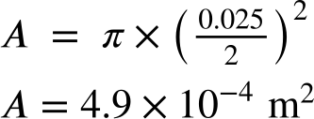
Using formulae in the construction industry
Plumbers use the formula below to calculate a flow rate.
Q = A × v
where Q is the flow rate, A is the flow area and v is the velocity
Water runs through a cylindrical pipe at a velocity of 10 m/s.
The diameter of the pipe is 25 mm.
What is the flow rate in m³ per hour?
Calculate the area of the cross-section of the pipe to 2 s.f.

Slide 17
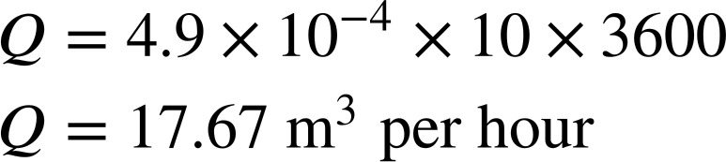
Using formulae in the construction industry
Plumbers use the formula below to calculate a flow rate.
Q = A × v
where Q is the flow rate, A is the flow area and v is the velocity
Water runs through a cylindrical pipe at a velocity of 10 m/s.
A = 4.9 × 10⁻⁴ m²
What is the flow rate (to 2 d.p.) in m³ per hour?

Slide 18
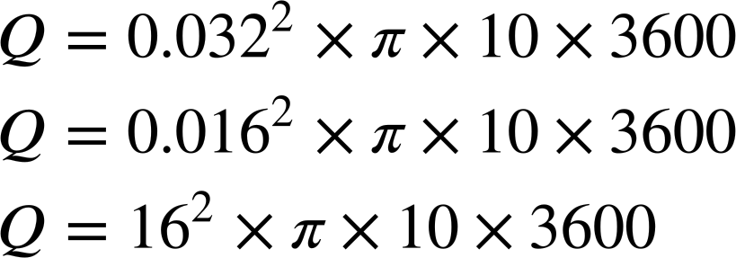

Using formulae in the construction industry
Plumbers use the formula below to calculate a flow rate.
Q = A × v
where Q is the flow rate, A is the flow area and v is the velocity
Water runs through a cylindrical pipe of diameter 32 mm at a velocity of 10 m/s.
Which of the following is the correct calculation for the flow rate in m³ per hour?

Slide 19
Using formulae in the construction industry
Electricians use Ohm’s law to determine the voltage, resistance or current of an electric circuit.
V = I × R
They also use this formula to calculate power.
P = I × V
where V is the voltage (volts) , I is the current (amps) and R is the resistance (ohms)
where P is the power (watts) , I is the current (amps) and V is the voltage (volts)

Slide 20
Using formulae in the construction industry
A 120 volt, 20 amp circuit is used to supply lamp posts for a car park.
How many lamp posts can be safely installed if the bulbs are 400 watts?
P = I × V
P = 20 × 120
P = 2400 watts
Number of lamp posts
= 2400 ÷ 400
= 6 lamp posts

Slide 21
Using formulae in the construction industry
Generally power is given in kilowatts (kW).
The power of a kettle is 2 kW.
How many watts is this?
How many watts are in a kilowatt?
The prefix kilo represents 1000.
What is the power of the kettle?
The power of the kettle is 2000 watts.

Slide 22
Using formulae in the construction industry
Calculate the power of the following household appliances in watts.
Shower = 8 kW
Water tank heater = 3 kW
Light bulb = 60 W
Vacuum cleaner = 0.9 kW
Fan heater = 2.4 kW
Hairdryer = 2.2 kW
Microwave = 1.5 kW
8000 W
3000 W
60 W
900 W
2400 W
2200 W
1500 W

Slide 23
Using formulae in the construction industry
The voltage of electricity in UK households is 230 volts.
An electrician needs to install a 8 kW shower.
Circuits are available in 6, 10, 16, 20, 32, 40, 50 and 63 amps.
Which circuit should be installed?
P = I × V
8000 = I × 230
I = 8000 ÷ 230
I = 34.8 amps (1 d.p.)
A 40 amp circuit should be installed.

Slide 24
Using formulae in the construction industry
The voltage of electricity in UK households is 230 volts.
An electrician is testing a 2 kW kettle for a fault.
The manufacturer’s information shows the resistance of the kettle as 25 ohms.
Is the kettle faulty?
V = I × R
230 = (2000 ÷ 230) × R
R = 230 ÷ (2000 ÷ 230)
R = 26.45 ohms
This is close to the expected value. Therefore it is unlikely that the kettle is faulty.
P = I × V
2000 = I × 230
I = (2000 ÷ 230) amps

Slide 25
Using formulae in the construction industry
P = I × V
The voltage of electricity in UK households is 230 volts therefore a 6 amp circuit should be installed for a 1.5 kW microwave.
I = 1500 ÷ 230
I = 6.52 amps (2 d.p.)
The current is higher than 6 amps. Therefore, a 6 amp circuit is not sufficient.

Slide 26
Using formulae in the construction industry
A plumber will use a formula to calculate the most appropriate size of radiators required for a room.
This is based on the size of the room, temperature the room needs to be heated to and the areas where heat is lost, e.g. windows.
Below is the formula to calculate BTU (British Thermal Units).
BTU = volume of the room × allowance for heat loss
Room | Allowance
Bathroom | 121.5
Bedroom | 108
Dining room | 135
Hallway | 81
Kitchen | 81
Living room | 135

Slide 27
Using formulae in the construction industry
Room | Allowance
Bathroom | 121.5
Bedroom | 108
Dining room | 135
Hallway | 81
Kitchen | 81
Living room | 135
Below are the dimensions of a living room.
Length = 7.6 m
Width = 6.3 m
Height = 2.3 m
Calculate the BTU.
BTU = volume of the room × allowance for heat loss
BTU = 7.6 × 6.3 × 2.3 × 135
BTU = 15 000 (2 s.f.)

Slide 28
Using formulae in the construction industry
The required BTU for the living room is 15 000.
Which are the most appropriate radiators for this room?
Height (mm) | Width (mm) | BTU
600 | 400 | 2184
600 | 600 | 3280
600 | 800 | 4372
600 | 1000 | 5464
600 | 1200 | 6556
600 | 1400 | 7649
600 | 1600 | 8744
Assume the room will have 2 radiators.
15 000 ÷ 2 = 7500 BTU
2 of the 600 × 1400 are the most appropriate for the size of the living room.
(This way we use radiators of the same size.)

Slide 29
Using formulae in the construction industry
The required BTU for a kitchen is 3208.
Which size of radiator should be used?
Height (mm) | Width (mm) | BTU
600 | 400 | 2184
600 | 600 | 3280
600 | 800 | 4372
600 | 1000 | 5464
600 | 1200 | 6556
600 | 1400 | 7649
600 | 1600 | 8744

Slide 30
Using formulae in the construction industry
1) Here are the front and side elevations of a shed.
A builder needs to replace the rafters of the shed.
How long are the rafters?
3 m
2.5 m
2.8 m
4 m

Slide 31
Using formulae in the construction industry
Using formulae in the construction industry
where Q is the flow rate, A is the flow area and v is the velocity
2) Q = A × v
Water runs through a cylindrical pipe at a velocity of 10 m/s.
The diameter of the pipe is 40 mm.
What is the flow rate in m³ per hour?

Slide 32
Using formulae in the construction industry
Using formulae in the construction industry
where P is the power (watts) , I is the current (amps) and V is the voltage (volts)
3) P = I × V
The voltage of electricity in UK households is 230 volts.
An electrician needs to install a 2.15 kW electric oven.
Circuits are available in 6, 10, 16, 20, 32, 40, 50 and 63 amps.
Which circuit should be installed?

Slide 33
Using formulae in the construction industry
Using formulae in the construction industry
4) BTU = volume of the room × allowance for heat loss
Below are the dimensions of a bedroom.
Length = 4.6 m
Width = 2.6 m
Height = 2.4 m
Calculate the BTU.
The bedroom will have one radiator.
Which size should be installed?
Room | Allowance
Bathroom | 121.5
Bedroom | 108
Dining room | 135
Hallway | 81
Kitchen | 81
Living room | 135
Height (mm) | Width (mm) | BTU
600 | 400 | 2184
600 | 600 | 3280
600 | 800 | 4372
600 | 1000 | 5464
600 | 1200 | 6556
600 | 1400 | 7649
600 | 1600 | 8744

Slide 34
Using formulae in the construction industry
1) Here are the front and side elevations of a shed.
A builder needs to replace the rafters of the shed.
How long are the rafters?
2.062 m (3 d.p.)
3 m
2.5 m
2.8 m
4 m

Slide 35
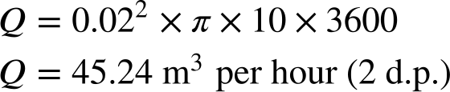
Using formulae in the construction industry
Using formulae in the construction industry
where Q is the flow rate, A is the flow area and v is the velocity
2) Q = A × v
Water runs through a cylindrical pipe at a velocity of 10 m/s.
The diameter of the pipe is 40 mm.
What is the flow rate in m³ per hour?

Slide 36
Using formulae in the construction industry
Using formulae in the construction industry
where P is the power (watts) , I is the current (amps) and V is the voltage (volts)
3) P = I × V
The voltage of electricity in UK households is 230 volts.
An electrician needs to install a 2.15 kW electric oven.
Circuits are available in 6, 10, 16, 20, 32, 40, 50 and 63 amps.
Which circuit should be installed?
I = 2150 ÷ 230
I = 9.35 amps (2 d.p.)
A 10 amp circuit should be installed.

Slide 37
Using formulae in the construction industry
Using formulae in the construction industry
4) BTU = volume of the room × allowance for heat loss
Below are the dimensions of a bedroom.
Length = 4.6 m
Width = 2.6 m
Height = 2.4 m
Calculate the BTU.
4.6 × 2.6 × 2.4 × 108 = 3100.032
The bedroom will have one radiator.
Which size should be installed?
600 × 600
Room | Allowance
Bathroom | 121.5
Bedroom | 108
Dining room | 135
Hallway | 81
Kitchen | 81
Living room | 135
Height (mm) | Width (mm) | BTU
600 | 400 | 2184
600 | 600 | 3280
600 | 800 | 4372
600 | 1000 | 5464
600 | 1200 | 6556
600 | 1400 | 7649
600 | 1600 | 8744

Slide 38
Construction
Using formulae in the construction industry
Costing in the construction industry

Slide 39
Costing in the construction industry
Let’s go back to the previous problem where the builder was replacing the rafters of the shed.
1.295 m
2.31 m
1.8 m
1.3 m
2.38 m
They need to replace 8 rafters.

Slide 40
Costing in the construction industry
This table shows the lengths and prices the wood is sold in.
Each rafter is 1.295 m in length.
How much will it cost to purchase the wood?
Length (mm) | Price
2400 | £4.20
3000 | £5.25
3600 | £6.30
4200 | £7.35
4800 | £8.40
Can we just find the total length of the 8 rafters and use this length?
No, the full lengths of each rafter need to be one piece.
Let’s calculate the number of rafters we can make from each length of wood.

Slide 41
Costing in the construction industry
This table shows the lengths and prices the wood is sold in.
Each rafter is 1.295 m in length.
How much will it cost to purchase the wood?
Length (mm) | Price
2400 | £4.20
3000 | £5.25
3600 | £6.30
4200 | £7.35
4800 | £8.40
Firstly, we need to make sure all of our measurements are in the same units.
Let’s convert them all into millimetres.

Slide 42
Costing in the construction industry
This table shows the lengths and prices the wood is sold in.
Each rafter is 1295 mm in length.
How much will it cost to purchase the wood?
Length (mm) | Price
2400 | £4.20
3000 | £5.25
3600 | £6.30
4200 | £7.35
4800 | £8.40
2400 ÷ 1295 = 1.85… → 1 rafter
3000 ÷ 1295 = 2.31… → 2 rafters
3600 ÷ 1295 = 2.77… → 2 rafters
4200 ÷ 1295 = 3.24… → 3 rafters
4800 ÷ 1295 = 3.70… → 3 rafters

Slide 43
Costing in the construction industry
2400 ÷ 1295 = 1.85… → 1 rafter
3000 ÷ 1295 = 2.31… → 2 rafters
3600 ÷ 1295 = 2.77… → 2 rafters
4200 ÷ 1295 = 3.24… → 3 rafters
4800 ÷ 1295 = 3.70… → 3 rafters
Length (mm) | Price
2400 | £4.20
3000 | £5.25
3600 | £6.30
4200 | £7.35
4800 | £8.40
If I am buying 2 rafters, which would be better value for money, the 3000 mm length or the 3600 mm length?
The 3000 mm length.

Slide 44
Costing in the construction industry
2400 ÷ 1295 = 1.85… → 1 rafter
3000 ÷ 1295 = 2.31… → 2 rafters
3600 ÷ 1295 = 2.77… → 2 rafters
4200 ÷ 1295 = 3.24… → 3 rafters
4800 ÷ 1295 = 3.70… → 3 rafters
Length (mm) | Price
2400 | £4.20
3000 | £5.25
3600 | £6.30
4200 | £7.35
4800 | £8.40
If I am buying 3 rafters, which would be better value for money, the 4200 mm length or the 4800 mm length?
The 4200 mm length.

Slide 45
Costing in the construction industry
2400 ÷ 1295 = 1.85… → 1 rafter
3000 ÷ 1295 = 2.31… → 2 rafters
3600 ÷ 1295 = 2.77… → 2 rafters
4200 ÷ 1295 = 3.24… → 3 rafters
4800 ÷ 1295 = 3.70… → 3 rafters
Length (mm) | Price
2400 | £4.20
3000 | £5.25
3600 | £6.30
4200 | £7.35
4800 | £8.40
What are my options for buying 8 rafters?
3 × 3 rafters (1 spare)
2 × 3 rafters + 1 × 2 rafters
There are other options but one of these will be the most cost effective. Can you spot why?

Slide 46
Costing in the construction industry
2400 ÷ 1295 = 1.85… → 1 rafter
3000 ÷ 1295 = 2.31… → 2 rafters
3600 ÷ 1295 = 2.77… → 2 rafters
4200 ÷ 1295 = 3.24… → 3 rafters
4800 ÷ 1295 = 3.70… → 3 rafters
Length (mm) | Price
2400 | £4.20
3000 | £5.25
3600 | £6.30
4200 | £7.35
4800 | £8.40
What are my options for buying 8 rafters?
3 × 3 rafters (1 spare) Cost = £22.05
2 × 3 rafters + 1 × 2 rafters Cost = £19.95

Slide 47
Costing in the construction industry
Length (mm) | Price
2400 | £4.20
3000 | £5.25
3600 | £6.30
4200 | £7.35
4800 | £8.40
The cheapest way of making 8 rafters each of length 1.5 m is £21.
2 rafters can be cut from the 3000 mm length with no wastage.
You need to buy 4 of these. 4 × 5.25 = £21

Slide 48
Costing in the construction industry
1) This table shows the prices and lengths wood is sold in.
Calculate the cheapest price for purchasing the following:
a) Twenty 1 m lengths
b) Fifteen 1.8 m lengths
c) 3 different ways to buy 600 1.2 m lengths
d) Why are there 3 different ways for part (c)?
Length (mm) | Price
2400 | £4.20
3000 | £5.25
3600 | £6.30
4200 | £7.35
4800 | £8.40

Slide 49
Costing in the construction industry
1) This table shows the prices and lengths wood is sold in.
Calculate the cheapest price for purchasing the following:
a) Twenty 1 m lengths
The 3000 mm length produces three 1 m lengths.
6 × 3000 mm lengths + 1 × 2400 mm length will give twenty 1 m lengths at a cost of £35.70
Length (mm) | Price
2400 | £4.20
3000 | £5.25
3600 | £6.30
4200 | £7.35
4800 | £8.40

Slide 50
Costing in the construction industry
1) This table shows the prices and lengths wood is sold in.
Calculate the cheapest price for purchasing the following:
b) Fifteen 1.8 m lengths
The 3600 mm length produces two 1.8 m lengths.
7 × 3600 mm lengths + 1 × 2400 mm length will give fifteen 1.8 m lengths at a cost of £48.30
Length (mm) | Price
2400 | £4.20
3000 | £5.25
3600 | £6.30
4200 | £7.35
4800 | £8.40

Slide 51
Costing in the construction industry
1) This table shows the prices and lengths wood is sold in.
Calculate the cheapest price for purchasing the following:
c) 3 different ways to buy 600 1.2 m lengths
300 × 2400 mm length = £1260
200 × 3600 mm length = £1260
150 × 4800 mm length = £1260
Length (mm) | Price
2400 | £4.20
3000 | £5.25
3600 | £6.30
4200 | £7.35
4800 | £8.40

Slide 52
Costing in the construction industry
1) This table shows the prices and lengths wood is sold in.
Calculate the cheapest price for purchasing the following:
d) Why are there 3 different ways for part (c)?
Because the 2400 mm, 3600 mm & 4800 mm lengths each produce no wastage and the cost per metre of wood is the same for all three.
Length (mm) | Price
2400 | £4.20
3000 | £5.25
3600 | £6.30
4200 | £7.35
4800 | £8.40

Slide 53
Construction
Many areas of the construction industry use formulae.
Units and accurate measurements are essential to ensure things like safety.
Costing is another really important factor of the construction industry.
Wastage is also considered when purchasing materials for jobs.

Slide 54

© Oak National Academy 2024.
Produced in partnership with Mathematics in Education and Industry.
Licensed on the Open Government Licence v3.0, except where otherwise stated. See Oak terms and conditions.

